Slide 1
Workshop in Data Science – Tutorial 2
10/11/2025

Slide 2
Updated Tentative Schedule
Date | Schedule
10.11 | Tutorial 2
17.11 | Optional 1X1 help
24.11 | Initial idea presentation
15.12 | Checkpoint
19.01 | Final presentation
15.03 | Project Submission

Slide 3
Guidelines for Initial Presentation

Slide 4
Topic
Put here:
Main dataset you’ve chosen from Kaggle/UN
Task/s
Motivation for this task
If from Kaggle – what was the original task and what did you change

Slide 5
Feasibility Analysis
Initial exploration of the data
Features
Correlations/Signal
Supporting datasets
Convince us that you can do the task give good enough modelling

Slide 6
Method
Initial approach – doesn’t need to be implemented
Work plan
Work Packages
Milestones
What would be a success? Evaluation ideas

Slide 7
Repeat for another topic
Same slides

Slide 8
Preferences
Either say what you prefer
Pros/Cons for each topic

Slide 9
Total time for both topics
Around 15 minutes for both topics + 5-10 minutes of questions.

Slide 10
Final Grade guidelines
Complexity – task
Document and Analysis
Implementation
Versatility
Originality – method
Presentation

Slide 11
Today
Feature Selection/Engineering
Predictive Modelling
Evaluation
Explainability

Slide 12
Why not just throw in all of your data at the model
Not always possible (Models expect certain inputs)
Curse of dimensionality
Simplicity sometimes is more important than accuracy
Learning noise instead of signal - overfitting

Slide 13

Feature Selection
Goal: Find a subset of features that maximizes model performance
Problem: Can’t test all subsets ($2^{features}$is huge)

Slide 14
Feature Selection
Wrapper methods: search subsets, train & evaluate each
Forward selection – start empty, add “strongest” features
Backward selection – start full, remove “weakest” features
Pros: Usually more accurate Cons: Computationally expensive
Filter methods: rank features by a proxy measure, then take top-N
Mutual information (feature ↔ target)
Correlation coefficient
Pros: Fast, model-agnostic Cons: Ignores feature interactions
Embedded methods: feature selection occurs during training (e.g., Lasso, Regularization)

Slide 15
Feature Engineering
Manipulate current features to create new better ones.
Transformations
Discretization (Binning)
One hot encoding
Dimensionality reduction (PCA, T-SNE)
Could require some expert knowledge

Slide 16
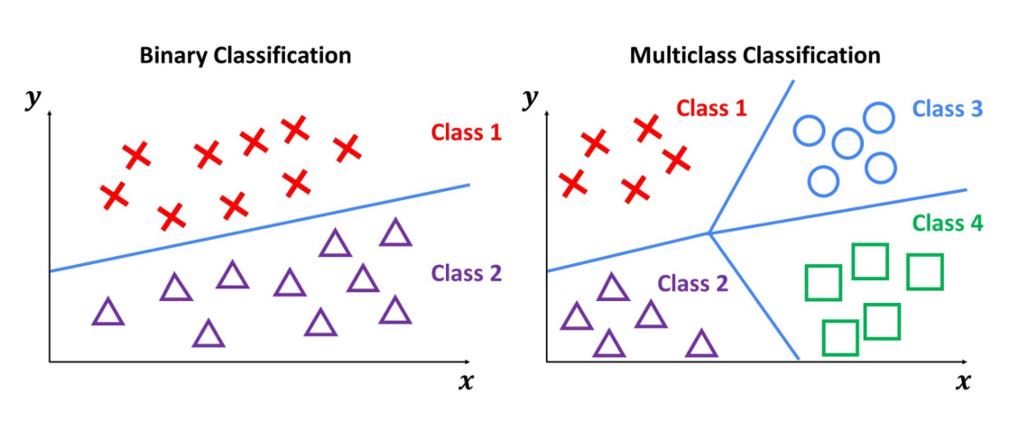
Modelling – types of prediction tasks
Classification

Slide 17
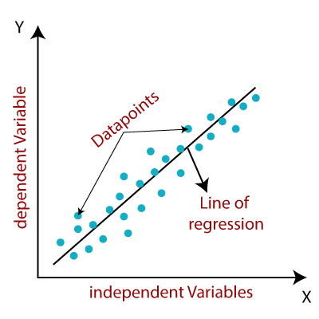
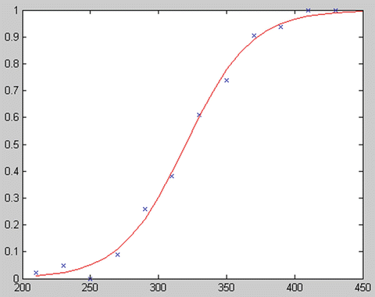
Modelling – types of prediction tasks
Classification
Regression

Slide 18
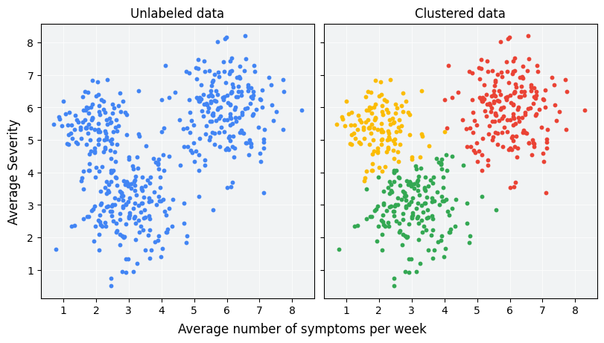
Modelling – types of prediction tasks
Classification
Regression
Clustering

Slide 19
Modelling – types of prediction tasks
Classification
Regression
Clustering
Ranking/Recommendation

Slide 20
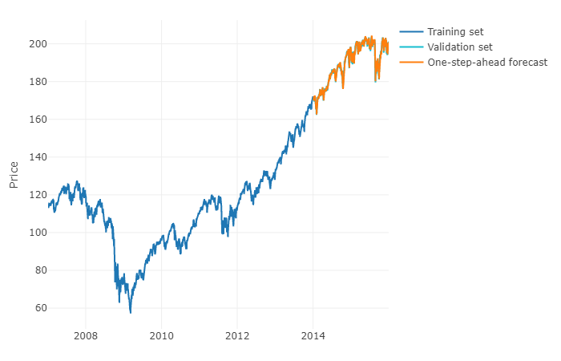
Modelling – types of prediction tasks
Classification
Regression
Clustering
Ranking/Recommendation
Time Series Forecasting

Slide 21
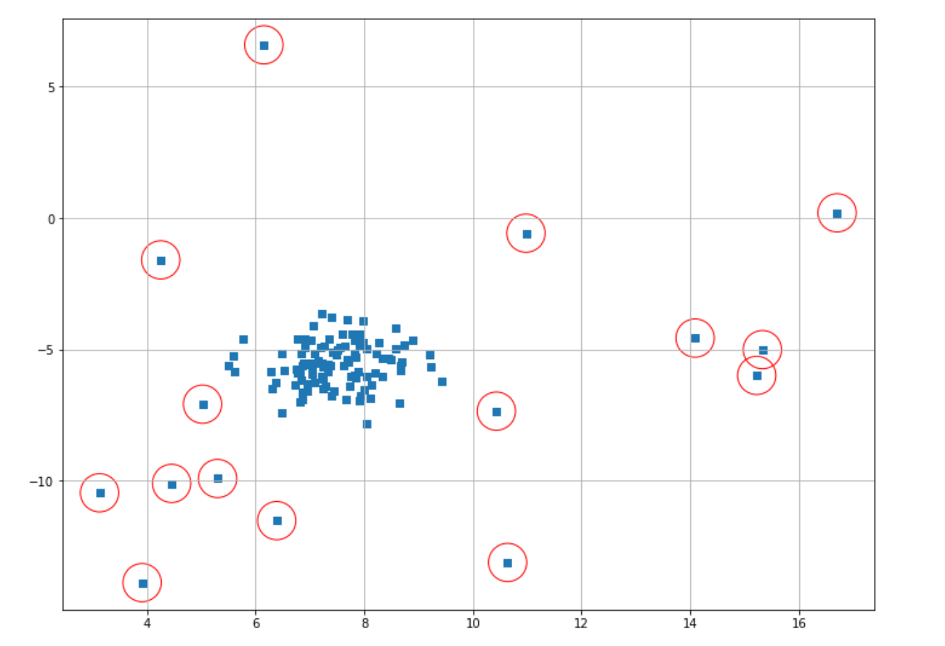
Modelling – types of prediction tasks
Classification
Regression
Clustering
Ranking/Recommendation
Time Series Forecasting
Anomaly Detection

Slide 22
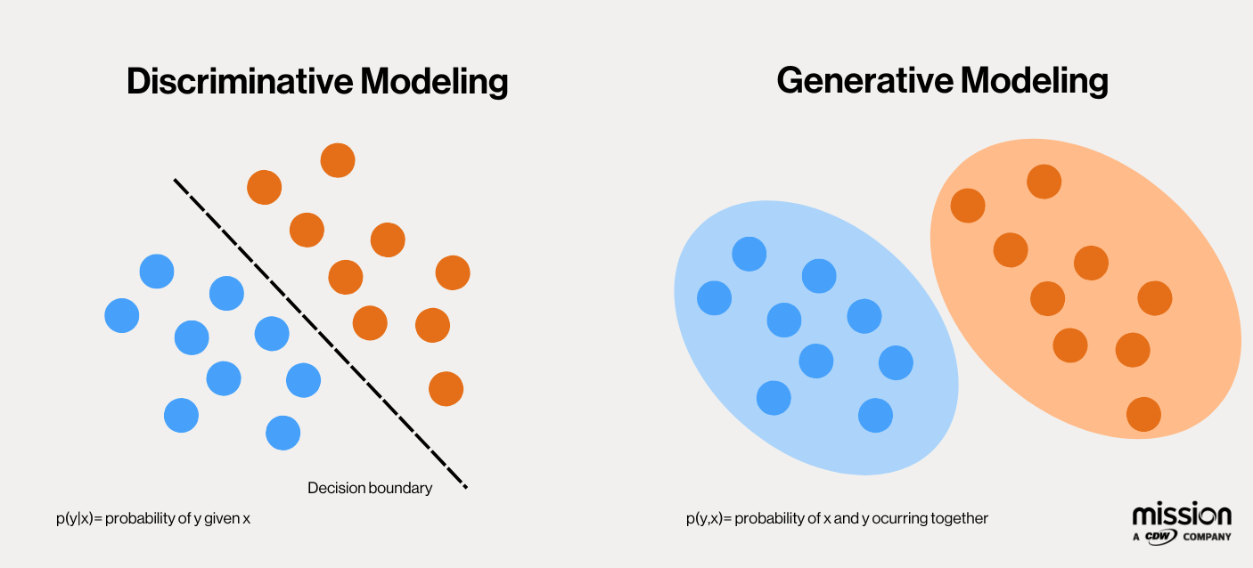
Modelling – types of prediction tasks
Classification
Regression
Clustering
Ranking/Recommendation
Time Series Forecasting
Anomaly Detection
Generative Tasks

Slide 23
Common models “in a nutshell”

Slide 24
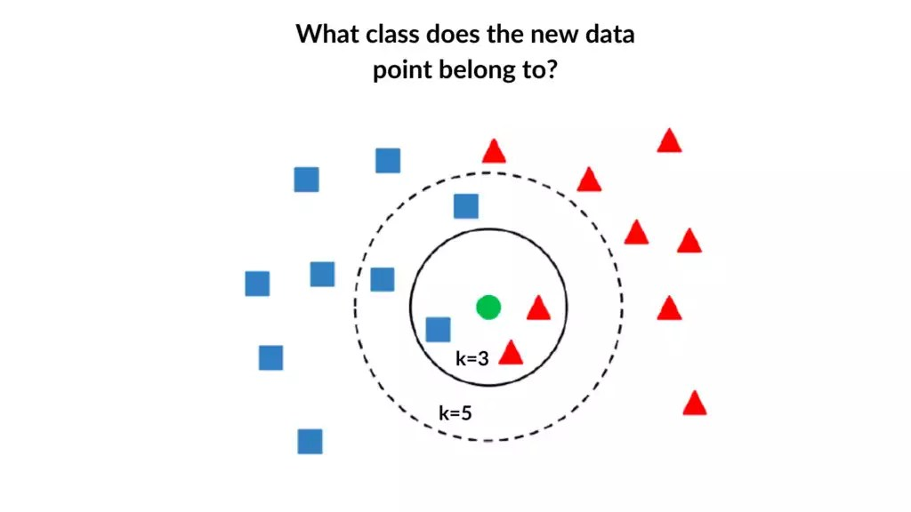
K-Nearest Neighbors (K-NN)
Classify a point based on the average of its K nearest neighbors
Simple, requires no training

Slide 25
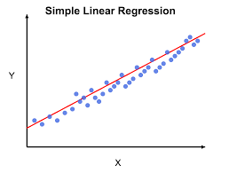

Linear Regression
Assumes linear relationship between variables.
$$y=β_{0}+β_{1}x$$
Can work with multiple features

Slide 26
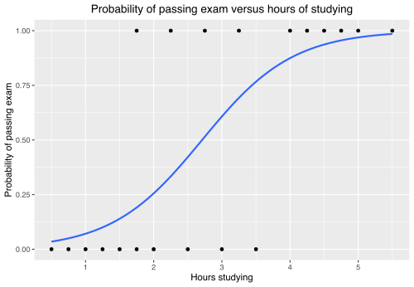

Logistic Regression
Regression for a variable between 0 and 1.
Often describes probabilities
$$y=\frac{e^{β_{0}+β_{1}x}}{1+e^{β_{0}+β_{1}x}}$$

Slide 27
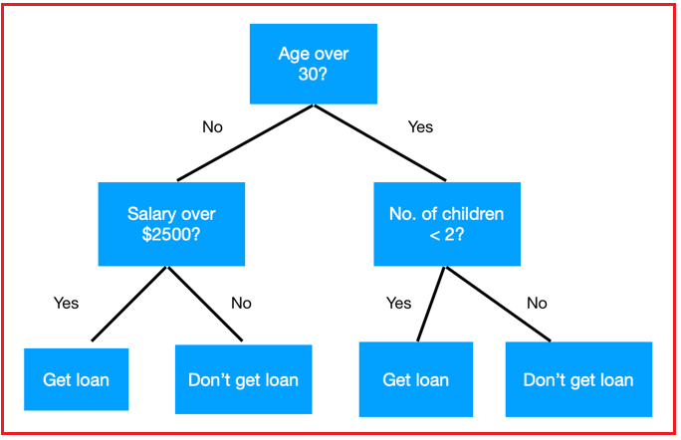
Decision Trees
Recursively splits the dataset into smaller, more homogeneous subsets based on the features.
Interpretable and versatile
Can lead to overfitting
Small changes in the data can affect the tree

Slide 28
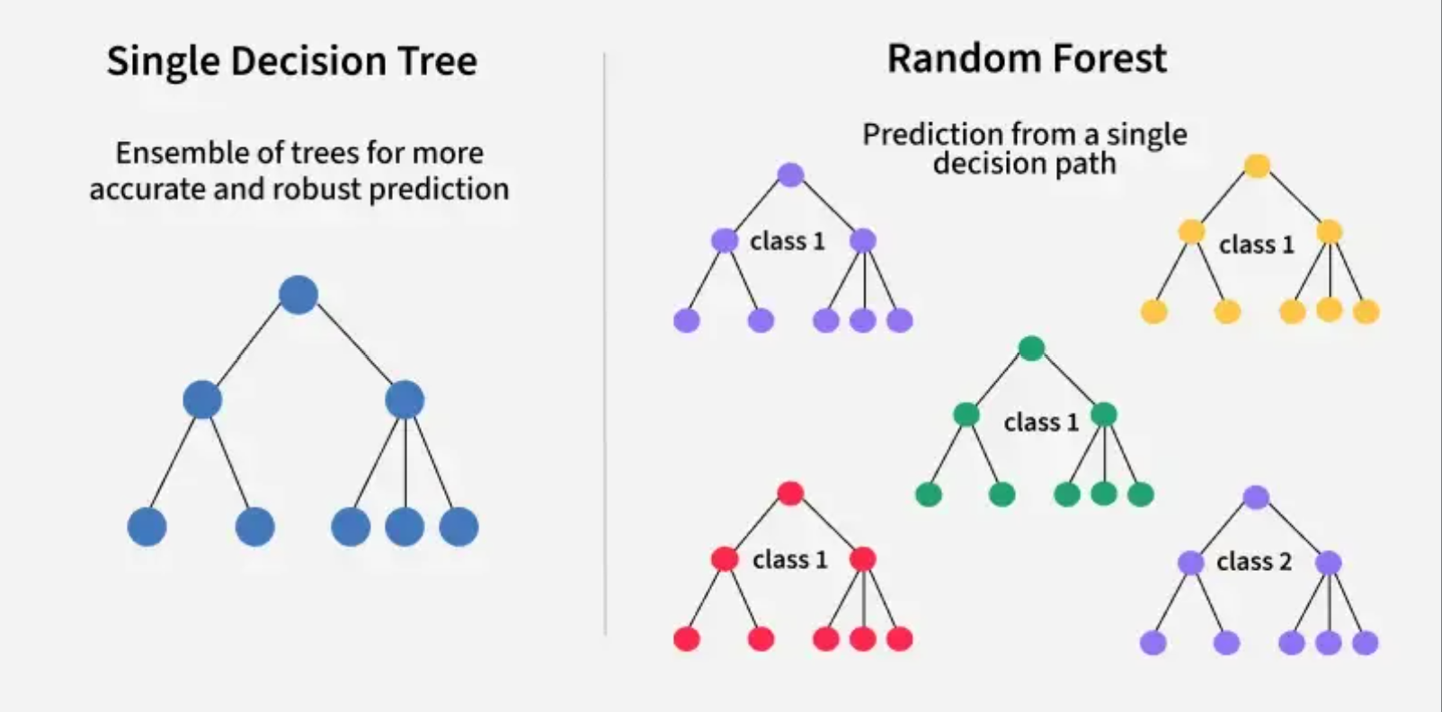
Random Forest
Training multiple decision trees on random samples of the data (bootstrapping).
Taking the average of the trees.
More robust.
Can describe more complex functions than decision trees

Slide 29
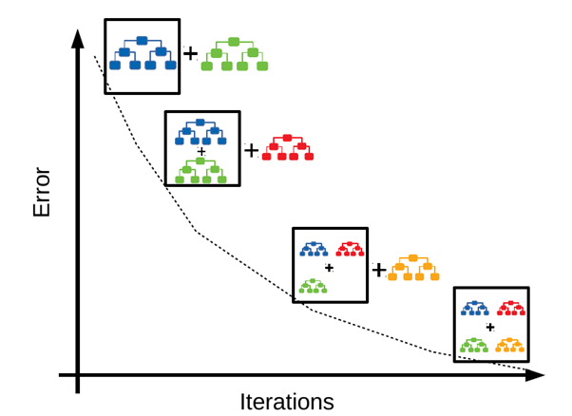
Gradient boosted trees (XGBoost)
Ensemble of decision trees built sequentially
Every new tree is supposed to capture the errors of the previous trees.
Very powerful, though can lead to overfitting

Slide 30

Neural Networks
Can model complex, non-linear relationships
Have a variant for all tasks
Easy to use with complex data, or complex outputs

Slide 31
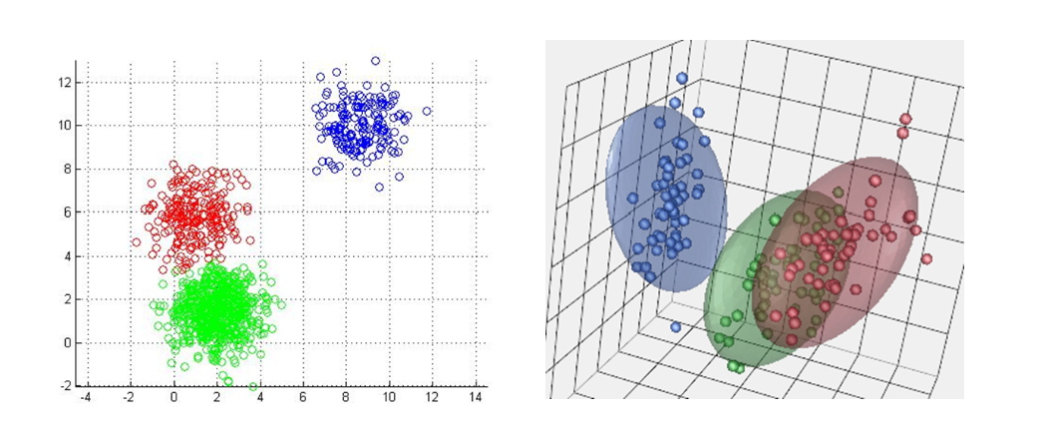
K-means/K-medians
Partitions data into k clusters minimizing intra-cluster distance.
simple and fast.
Means – choose any point as center; Median – choose a data point as center.

Slide 32
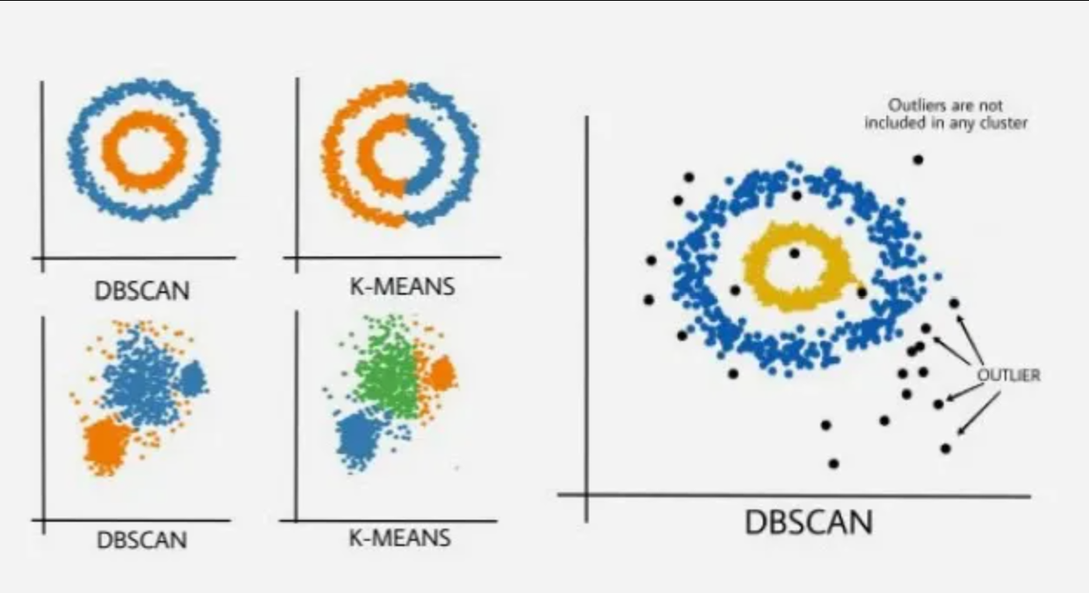
DBScan
Density based clustering
Arbitrary-Shaped Clusters
Can leave points without clusters (“noise”)

Slide 33
Evaluation

Slide 34
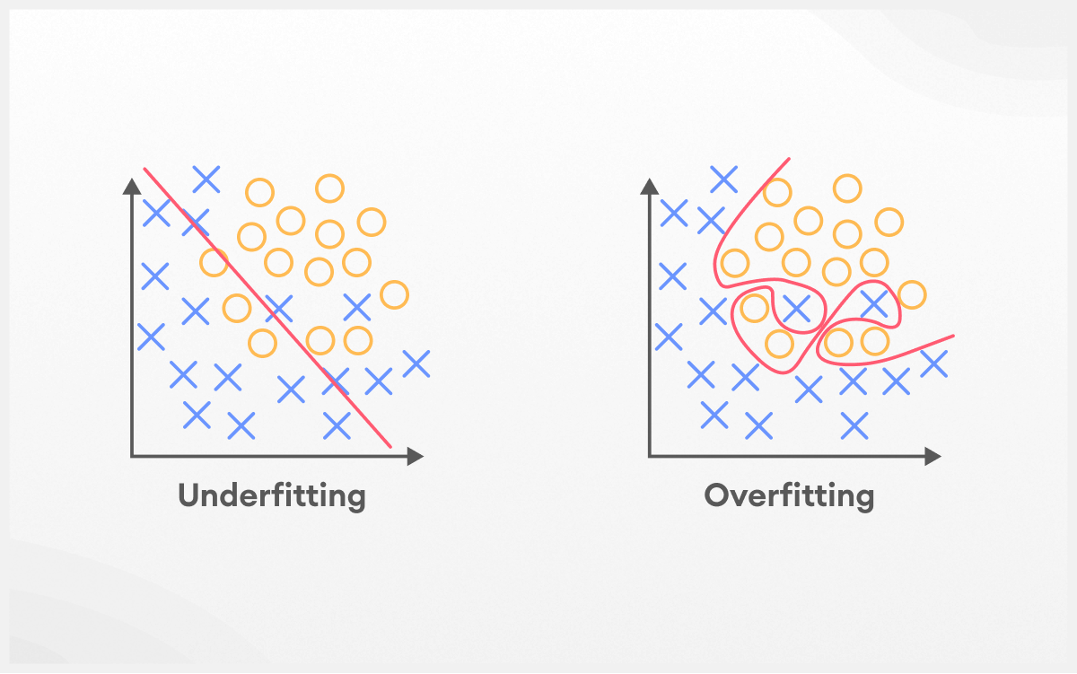
Underfitting and Overfitting
A good model:
It learns patterns effectively from the data.
It generalizes well to new, unseen data.
It avoids memorizing the training data (overfitting) or failing to capture relevant patterns (underfitting).
Overfitting happens when a model learns too much from the training data, including details that don’t matter (like noise or outliers).
Underfitting is the opposite of overfitting. It happens when a model is too simple to capture what’s going on in the data.

Slide 35
Modelling – Data partition
Partition your data into:
Train set (70-80% of the data); Validation set (10-15%); Test Set (10-15%)
Validation is for parameter tuning – never use the test set of that.
Common Methods include:
Simple random split
k-fold cross-validation – multiple iterations of leave one out
Stratified sampling – each subset maintains proportion of classes (good for imbalanced classes)
Nested cross-validation – inner CV for model selection/hyperparameters and outer CV for for model evaluation

Slide 36
Model Evaluation - classification
 |  | Predicted Condition
Actual Condition | Total Population = P + N | Positive (PP) | Negative (PN)
 | Positive (P) | True Positive (TP) | False Positive (FP)
 | Negative (N) | False Negative (FN | True Negative (TN)

Slide 37
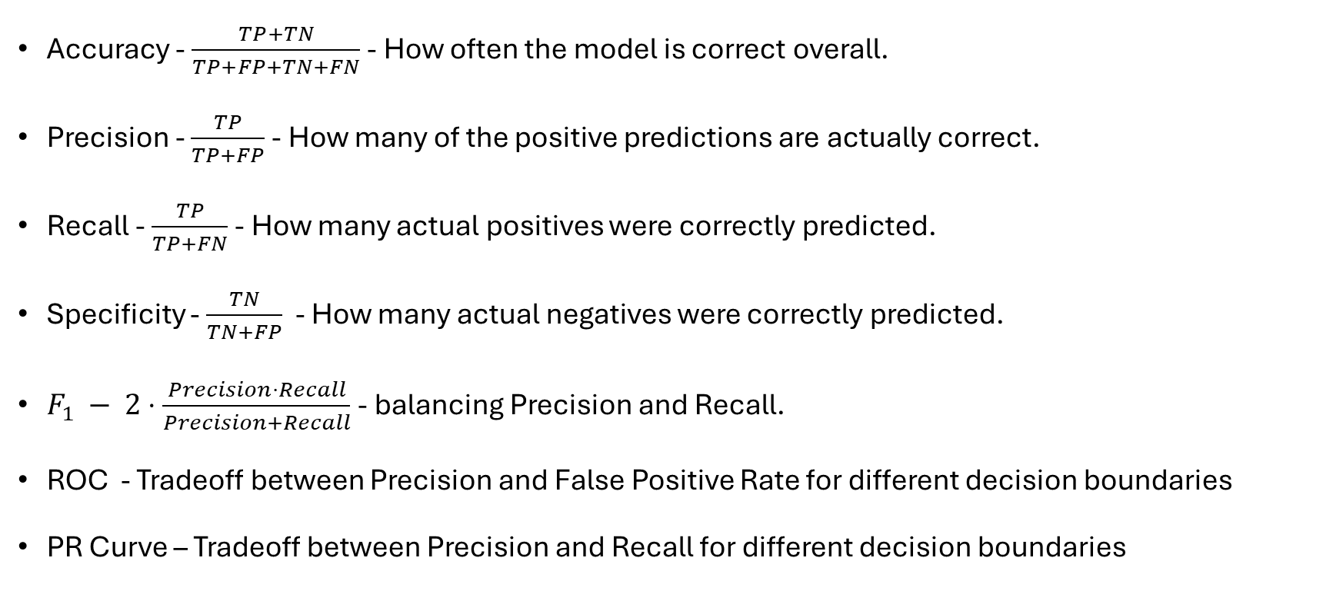
Model Evaluation - classification
Accuracy - $\frac{TP+TN}{TP+FP+TN+FN}$ - How often the model is correct overall.
Precision - $\frac{TP}{TP+FP}$ - How many of the positive predictions are actually correct.
Recall - $\frac{TP}{TP+FN}$ - How many actual positives were correctly predicted.
Specificity - $\frac{TN}{TN+FP}$ - How many actual negatives were correctly predicted.
$F_{1} −$ $2⋅\frac{Precision⋅Recall}{Precision+Recall}$ - balancing Precision and Recall.
ROC - Tradeoff between Precision and False Positive Rate for different decision boundaries
PR Curve – Tradeoff between Precision and Recall for different decision boundaries

Slide 38
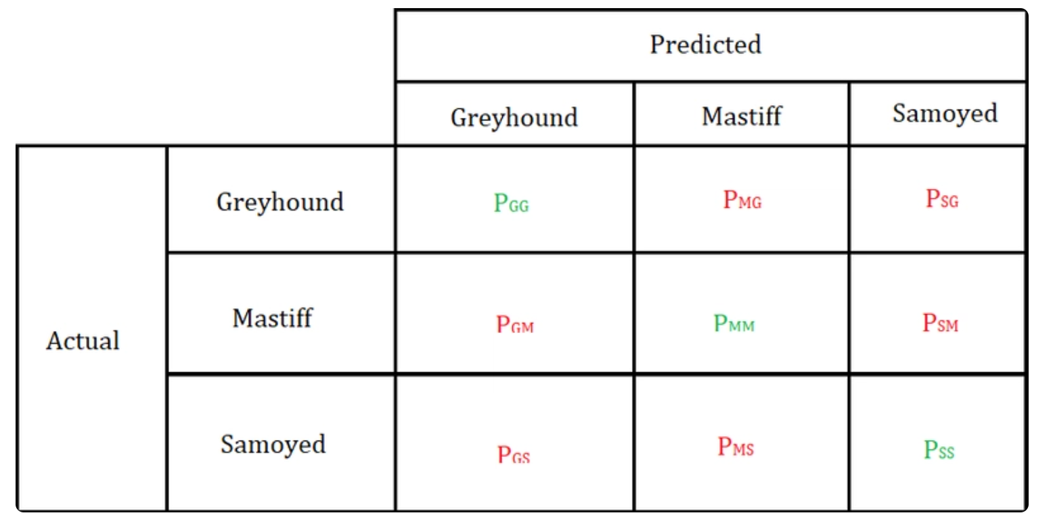

Model Evaluation - classification
Most methods generalize to multi-class classification
One vs All and All vs All analysis
Cross entropy - $L=−\sum_{i}{y_{i}⋅\log\left(\hat{y_{i}}\right)}$
MCC (Matthews Correlation Coefficient)

Slide 39
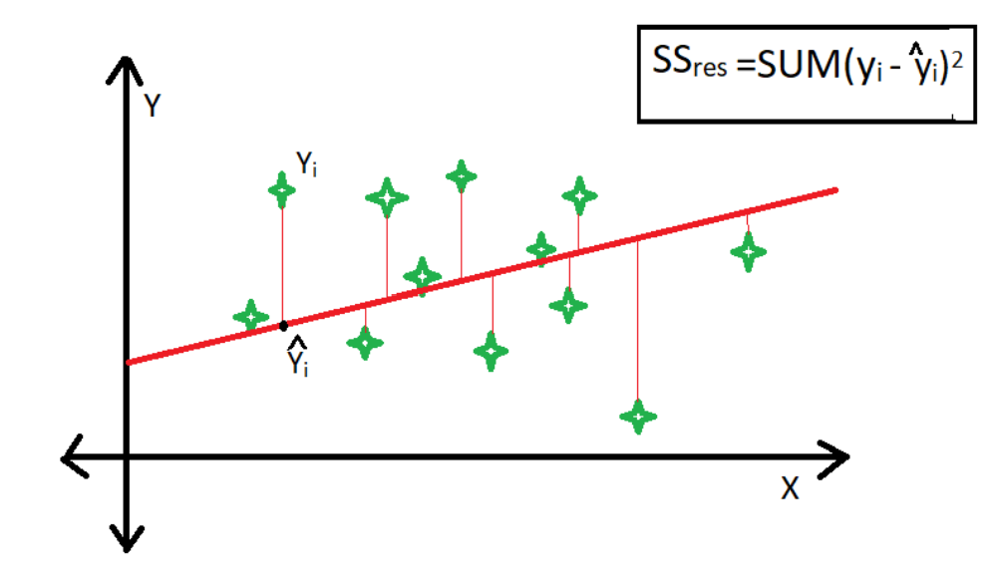
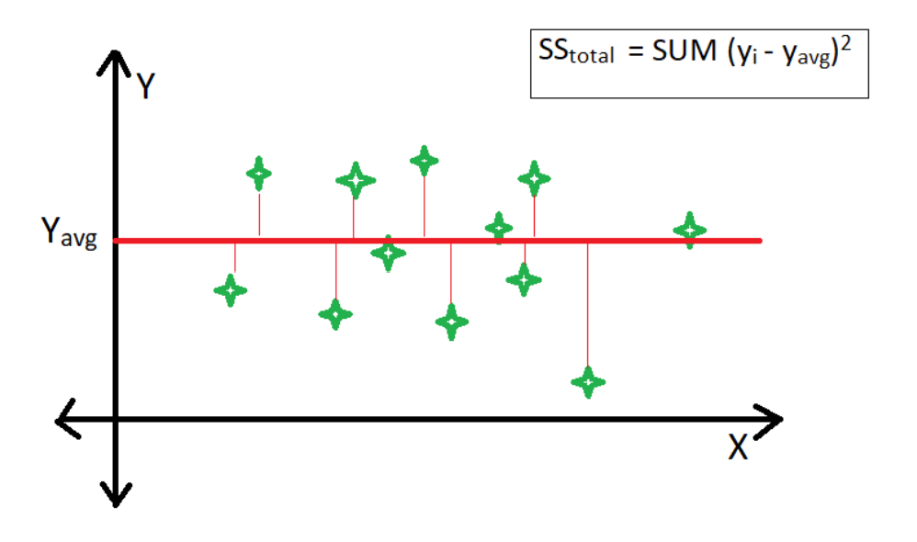
Evaluation - regression
Mean Squared Error (MSE)
Mean Absolute Error (MAE)
R² - proportion of variance explained by the model

Slide 40
Explainability
Global explanations try to explain the model’s overall behavior
Local explanations try to explain a specific prediction of the model
Some models have Intrinsic explainability (e.g. decision trees, linear regression) while others require Post Hoc explainability.

Slide 41
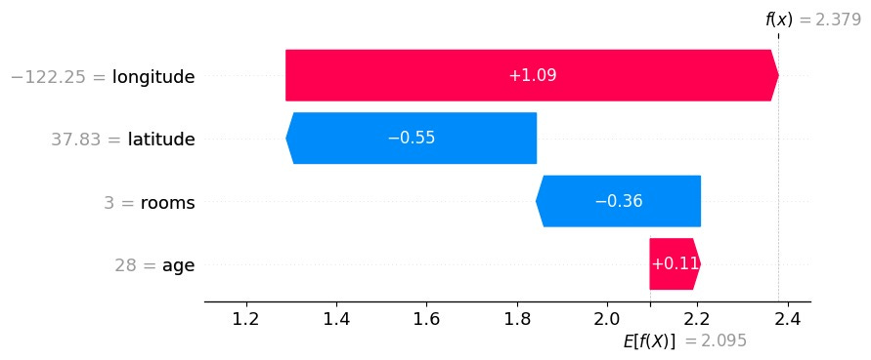
Local Explainability
SHAP(SHapley Additive exPlanations)

Slide 42
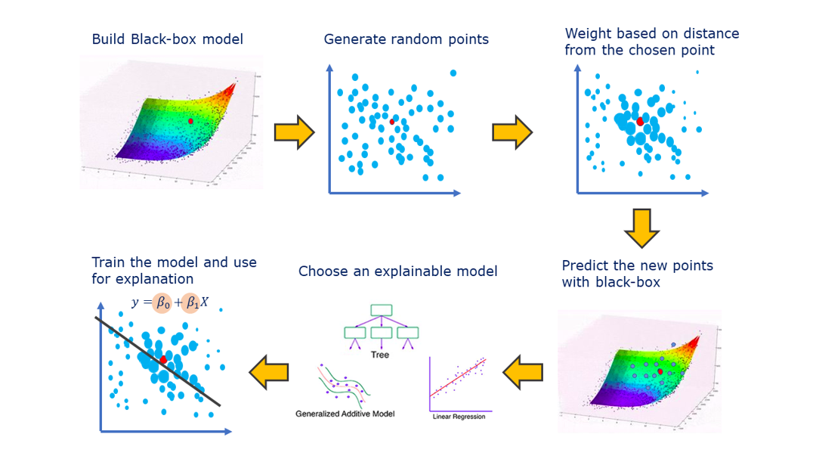
Local Explainability
SHAP(SHapley Additive exPlanations)
LIME

Slide 43
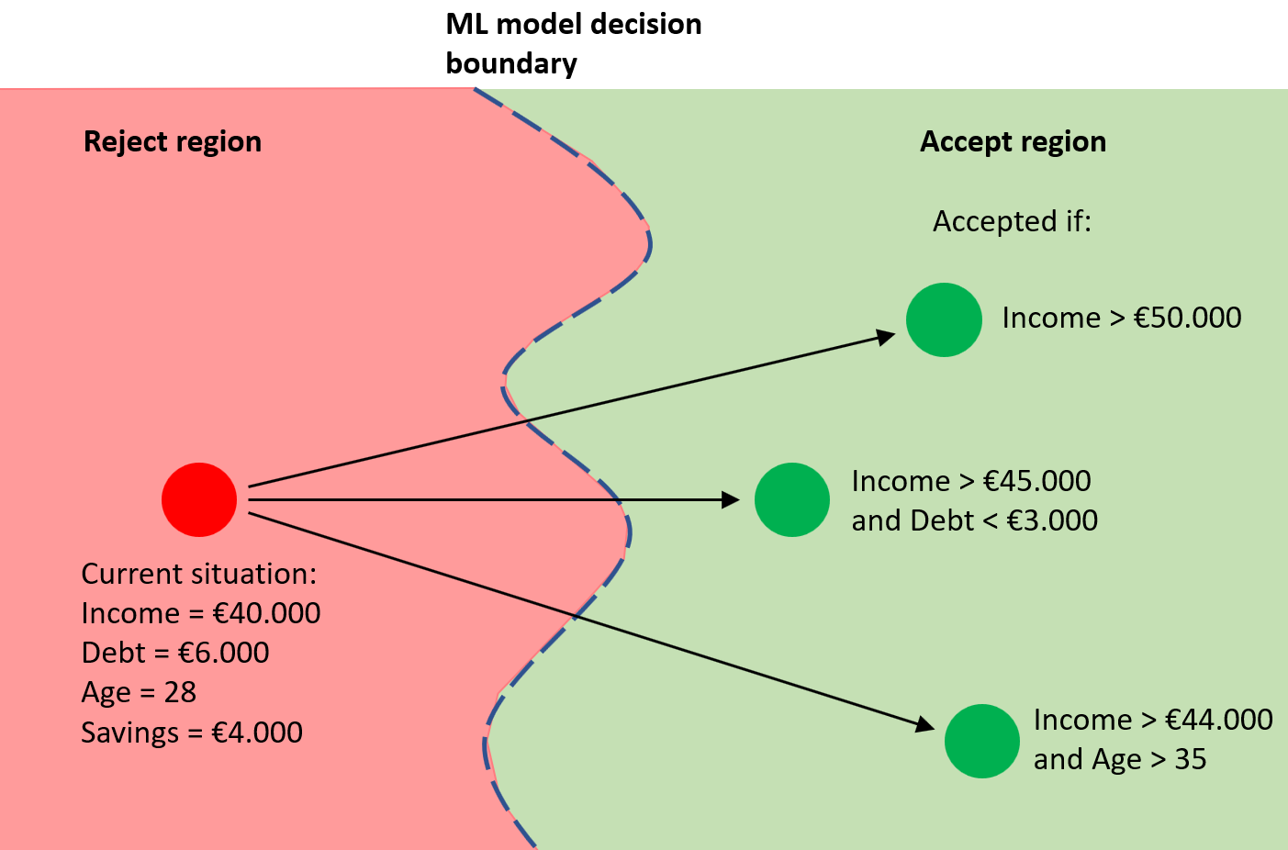
Local Explainability
SHAP(SHapley Additive exPlanations)
LIME
Counterfactuals

Slide 44
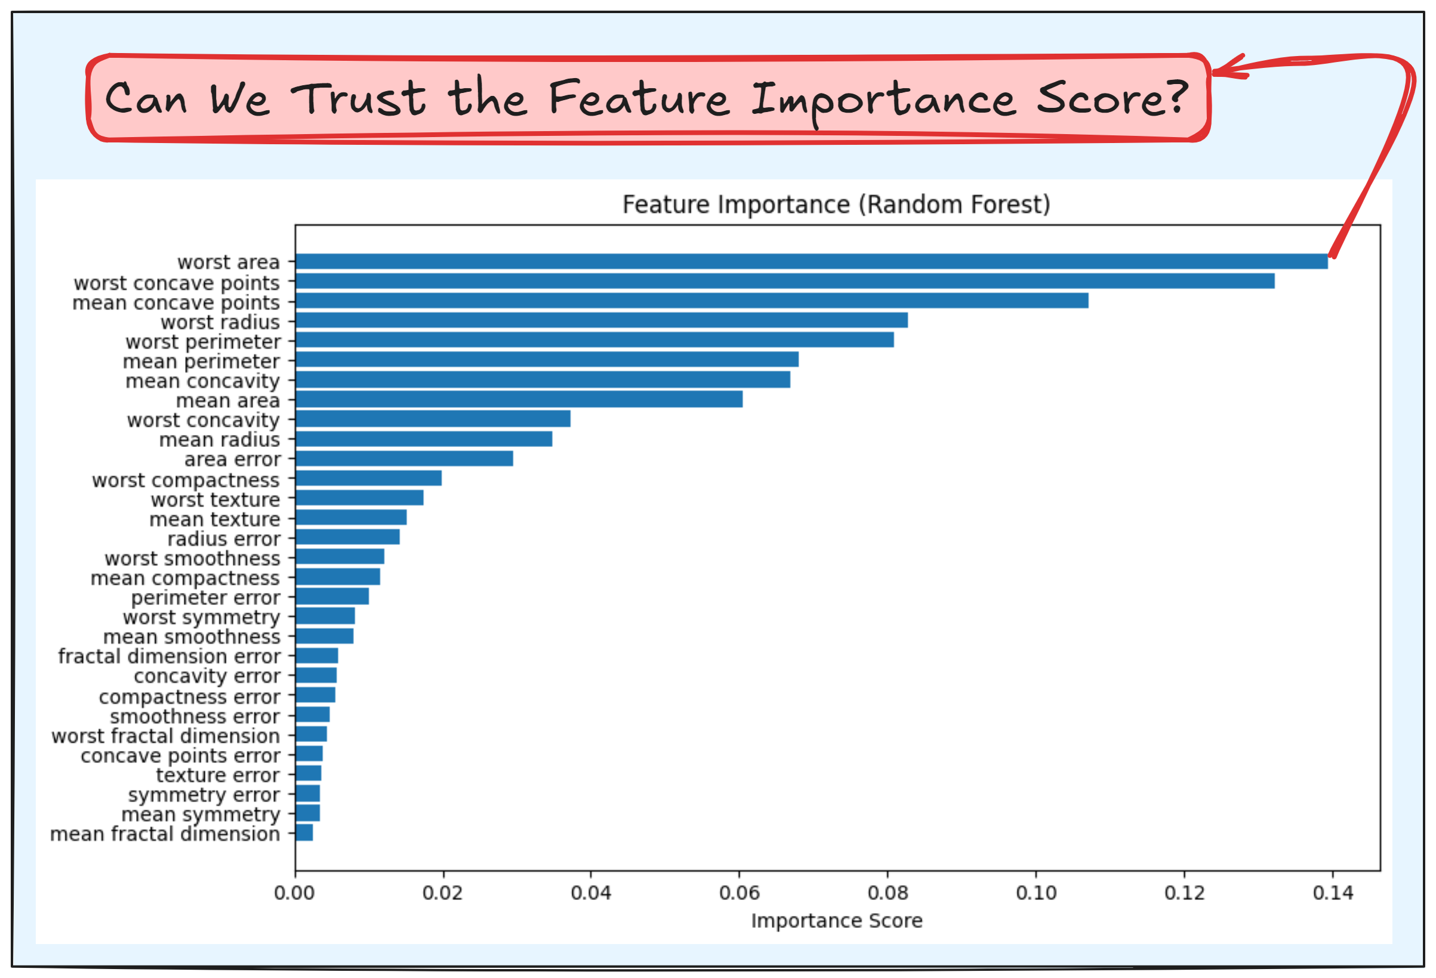
Global Explainability
Global Feature Importance

Slide 45
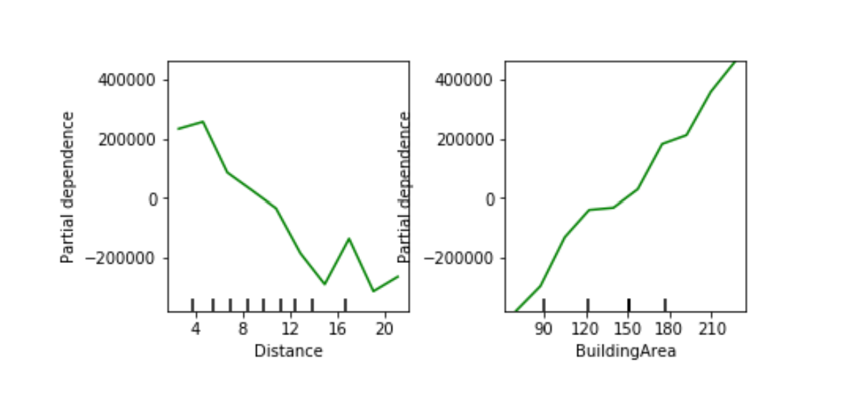
Global Explainability
Global Feature Importance
Partial Dependence Plot (PDP)

Slide 46
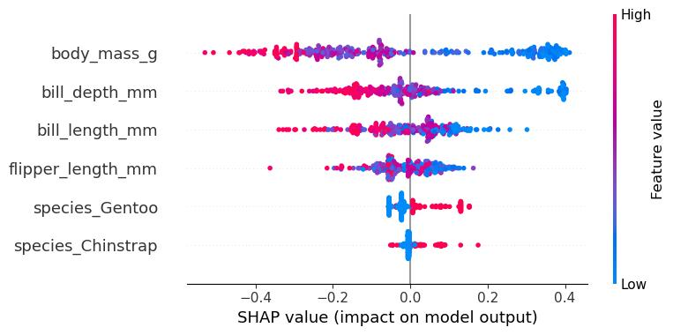
Global Explainability
Global Feature Importance
Partial Dependence Plot (PDP)
SHAP (SHapley Additive exPlanations)

Slide 47
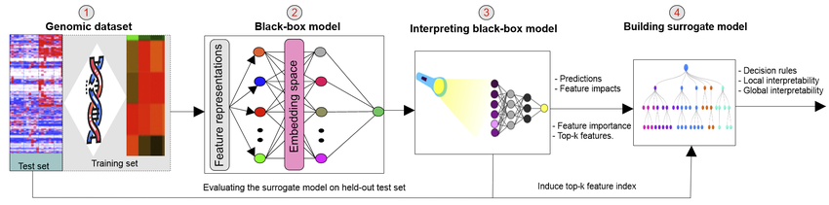
Global Explainability
Global Feature Importance
Partial Dependence Plot (PDP)
SHAP (SHapley Additive exPlanations)
Surrogate models

Slide 48
Things we didn’t cover enough

Slide 49
Time series analysis and forecasting
Features must preserve temporal relationship
Seasonality is a large issue
Requires specific cleaning and feature engineering techniques

Slide 50
Textual Analysis
How to represent text?
Bag of words
N-grams
Embeddings
Textual cleaning (misspellings, stopword removal, lemmatization etc.)

Slide 51
Image Analysis
Many representation methods
Usually requires a lot of preprocessing
Many possible tasks (though not necessarily relevant for your project)

Slide 52
Questions?

